Slide 1
Summary of Optimization using GAMS and Pyomo

Slide 2
Agenda
Solve a business problem
How to developed a model?
An overview of mathematical optimization
Types of optimization problems
How to solve a model?
Coding in GAMS and Pyomo
Our journey

Slide 3
Solve a business problem
Business problem
1. Mathematical modeling
2. Call an optimization solver
Optimal decision

Slide 4
How to developed a model?
12 different examples
Strategic advertisement planning
Staff allocation
Nonlinear regression
Resource allocation
Scheduling
Commodities pricing
Yield management
How to model conditional statements
How to model ‘either-or’ statements
How to model discontinuous variables and functions

Slide 5
An overview of mathematical optimization
A typical optimization problem contains

Slide 6
An overview of mathematical optimization
A typical optimization problem contains
Objective function

Slide 7
An overview of mathematical optimization
A typical optimization problem contains
Objective function
Decision variables

Slide 8
An overview of mathematical optimization
A typical optimization problem contains
Objective function
Decision variables
Constraints

Slide 9
An overview of mathematical optimization
A typical optimization problem contains
Objective function
Decision variables
Constraints
Bounds

Slide 10
An overview of mathematical optimization
A typical optimization problem contains
Objective function
Decision variables
Constraints
Bounds
Parameters
Coefficients

Slide 11
Types of optimization problems
Objective function and/or constraints are nonlinear
Linear programming
(LP)
Nonlinear programming
(NLP)
Mixed Integer Linear Programming
(MILP)
Mixed Integer Nonlinear Programming
(MINLP)
Some/all variables are integer variables
Some/all variables are integer variables

Slide 12



How to solve a model?
GAMS
Pyomo (Python)

Slide 13
Coding in GAMS and Pyomo
Defining different optimization model components
Model assembly
Calling a solver
Printing results
Defining lower and upper bounds on variables
Defining starting point solution for variables
Exporting results into different file formats (.txt, .gdx, .xls, .json)
Importing data from different file formats (.txt, .gdx, .xls, .json)
Setting stopping criteria for the solvers
Submitting jobs on NEOS server

Slide 14
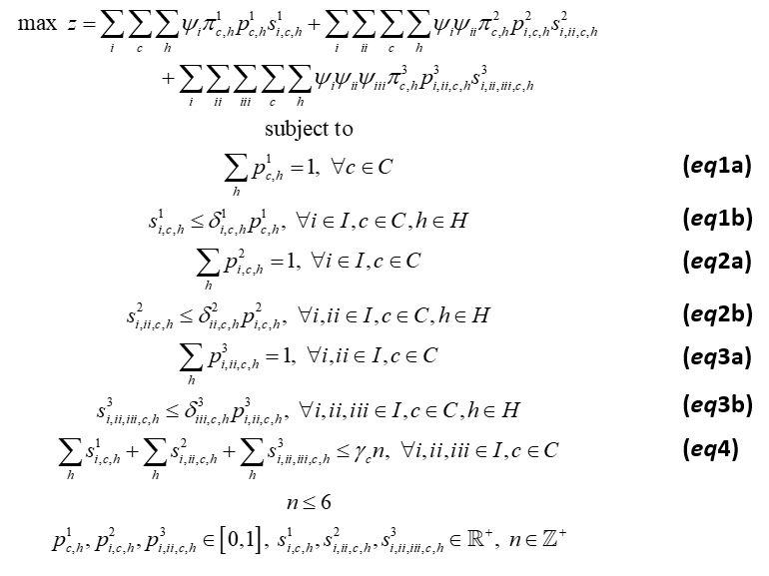
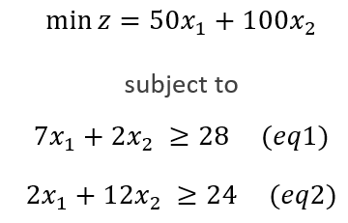
Our journey

Slide 15
Thank you for being part of this learning experience!

